Slide 1
ENCRYPTED GMAIL

Slide 2
Objective
A web app to send emails using Gmail but in encrypted format.
Key exchange implemented through asymmetric cryptography (Elliptic Curve)
Message encryption by Advanced Encryption Standard (AES) using Stanford Javascript Crypto Library (SJCL).

Slide 3
Motivation
While sending emails on Gmail we cannot be sure whether the information remains confidential since Google can still access the mails.
We wanted to make sure that the content is only accessible to the desired recipient and no one else has access to the message shared.

Slide 4
Methodology
Built UI on the top of the basic UI available here
Used SJCL library provided by Stanford for encryption and decryption purposes.
Used Django as the backend framework and it’s native SQLite database for storing metadata related to encryption
Achieved secure key exchange through asymmetric cryptography (ElGamel through Elliptic Curve).

Slide 5
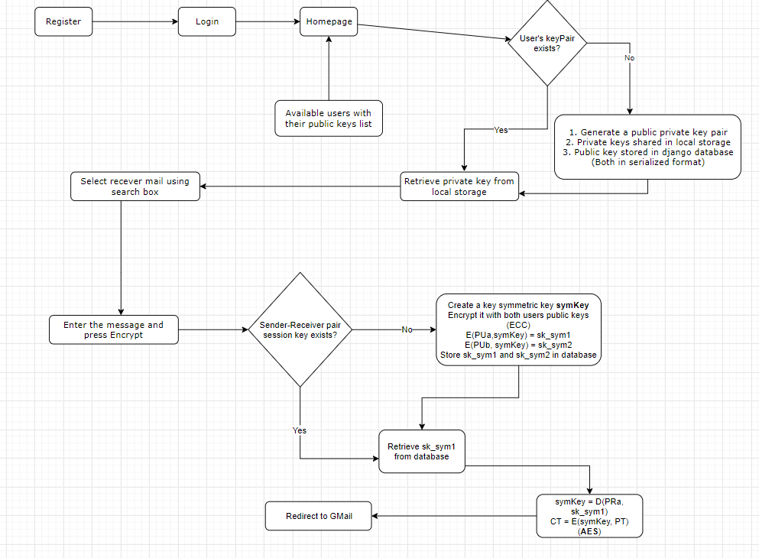
Flowchart

Slide 6
Implementation Details
If sender-receiver pair session key does not already exist, a symmetric key symKey is created.
It is encrypted with both users’ public keys (through Elliptic Curve Cryptography)
E(PUa, symKey) = sk_sym1
E(PUb, symKey) = sk_sym2

Slide 7
Using Advanced Encryption Standard (AES):
symKey = D(PRa, sk_sym1)
CT = E(symKey, PT)

Slide 8
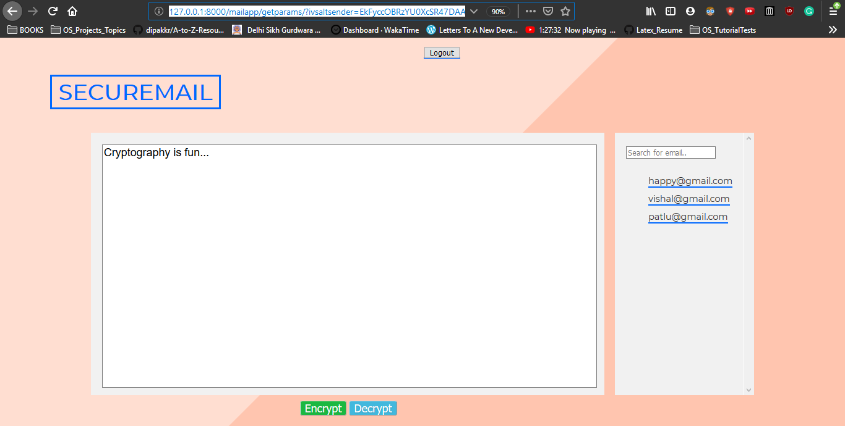
Web Application

Slide 9
Tech Stack Used
HTML, CSS, JS : For frontend
Python, Django: For backend
SJCL (Stanford Javascript Crypto Library): For encrypting and decrypting the messages and for key exchange

Slide 10
Harpinder Jot Singh, 2017A7PS0057P
Vishal Mittal, 2017A7PS0080P

